Slide 1

Level up
Michal Tabiš

Slide 2
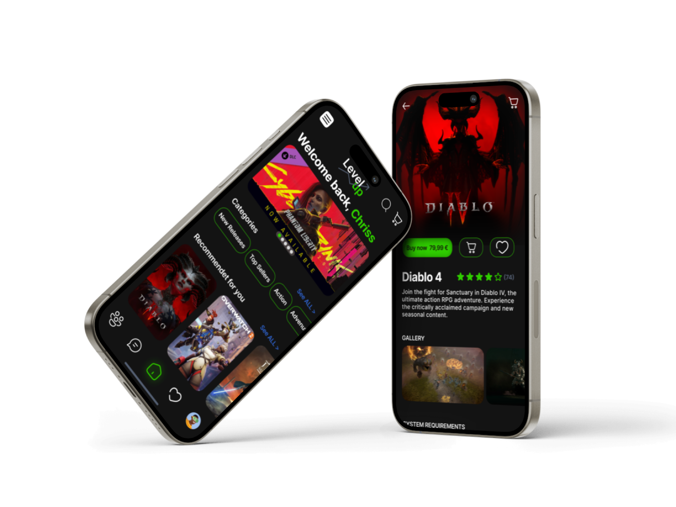
Project overview
The product:
Level UP is gaming platform designed to empower gamers with access to the latest game releases, a community space, and communication between gamers.
Project duration:
October 2023 - November 2023

Slide 3
Project overview
The problem:
Gamers often lack a centralised platform to provide reliable information, customer reviews and seamless purchasing of the latest game titles.
The goal:
Creating an app and e-shop that offers a wide selection of new games but also provides a user-friendly interface for discovering, exploring and purchasing new releases. The app should prioritise user engagement, community building and a seamless customer experience, with the ultimate goal of improving the overall user gaming experience

Slide 4
Project overview
My role: Lead UX designer
Responsibilities: User research, wireframing, prototyping,

Slide 5
Personas
Problem statements
User journey maps
Understanding
the user

Slide 6
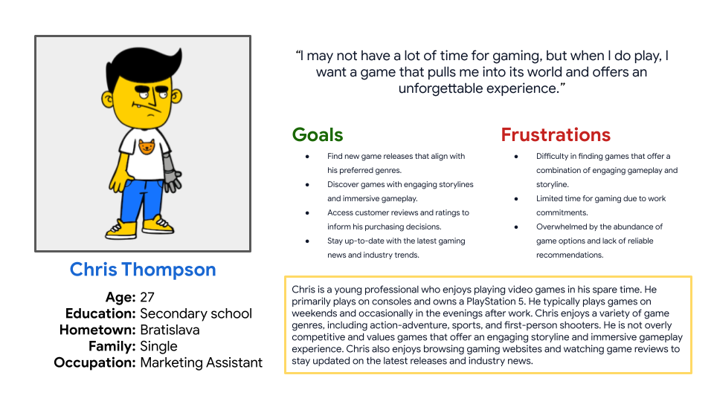

Persona: Chris
Problem statement:
Chris is a casual gamer who needs a reliable and efficient way to find new video game releases that align with his preferred genres and offer a combination of engaging gameplay and an immersive storyline. He also seeks access to customer reviews and ratings to make informed purchasing decisions.

Slide 7
User research: pain points
1
2
3
4
Limited Game Selection
Complicated Navigation
Limited Product Information
Lack of Personalized Recommendations
Users may find it frustrating when a gaming app has a limited selection of games, leaving them with few options to choose from.
A website that lacks intuitive navigation or has a complex user interface can confuse users and make it difficult for them to find the products they are looking for.
If essential product details, such as specifications, pricing, or availability, are not clearly presented, users may become frustrated and abandon their purchase.
Users may feel overwhelmed when an e-commerce website does not provide personalized product recommendations, making it harder to discover items that align with their preferences.

Slide 8
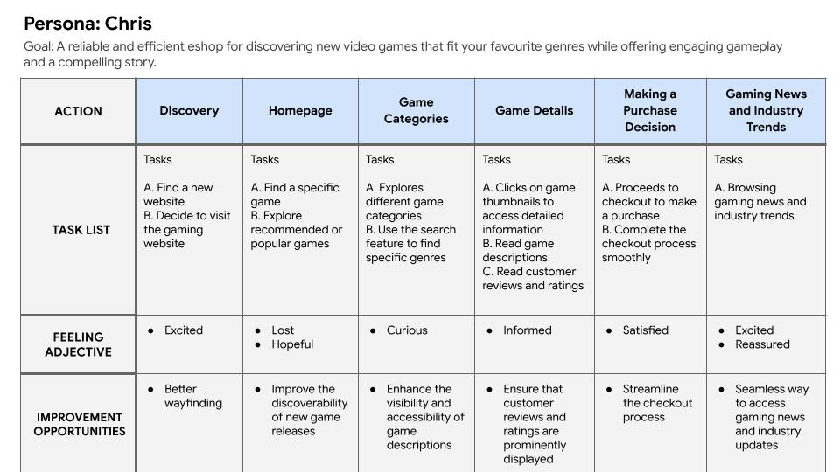
User journey map
[Your notes about goals and thought process]

Slide 9
Paper wireframes
Digital wireframes
Low-fidelity prototype
Starting
the design

Slide 10
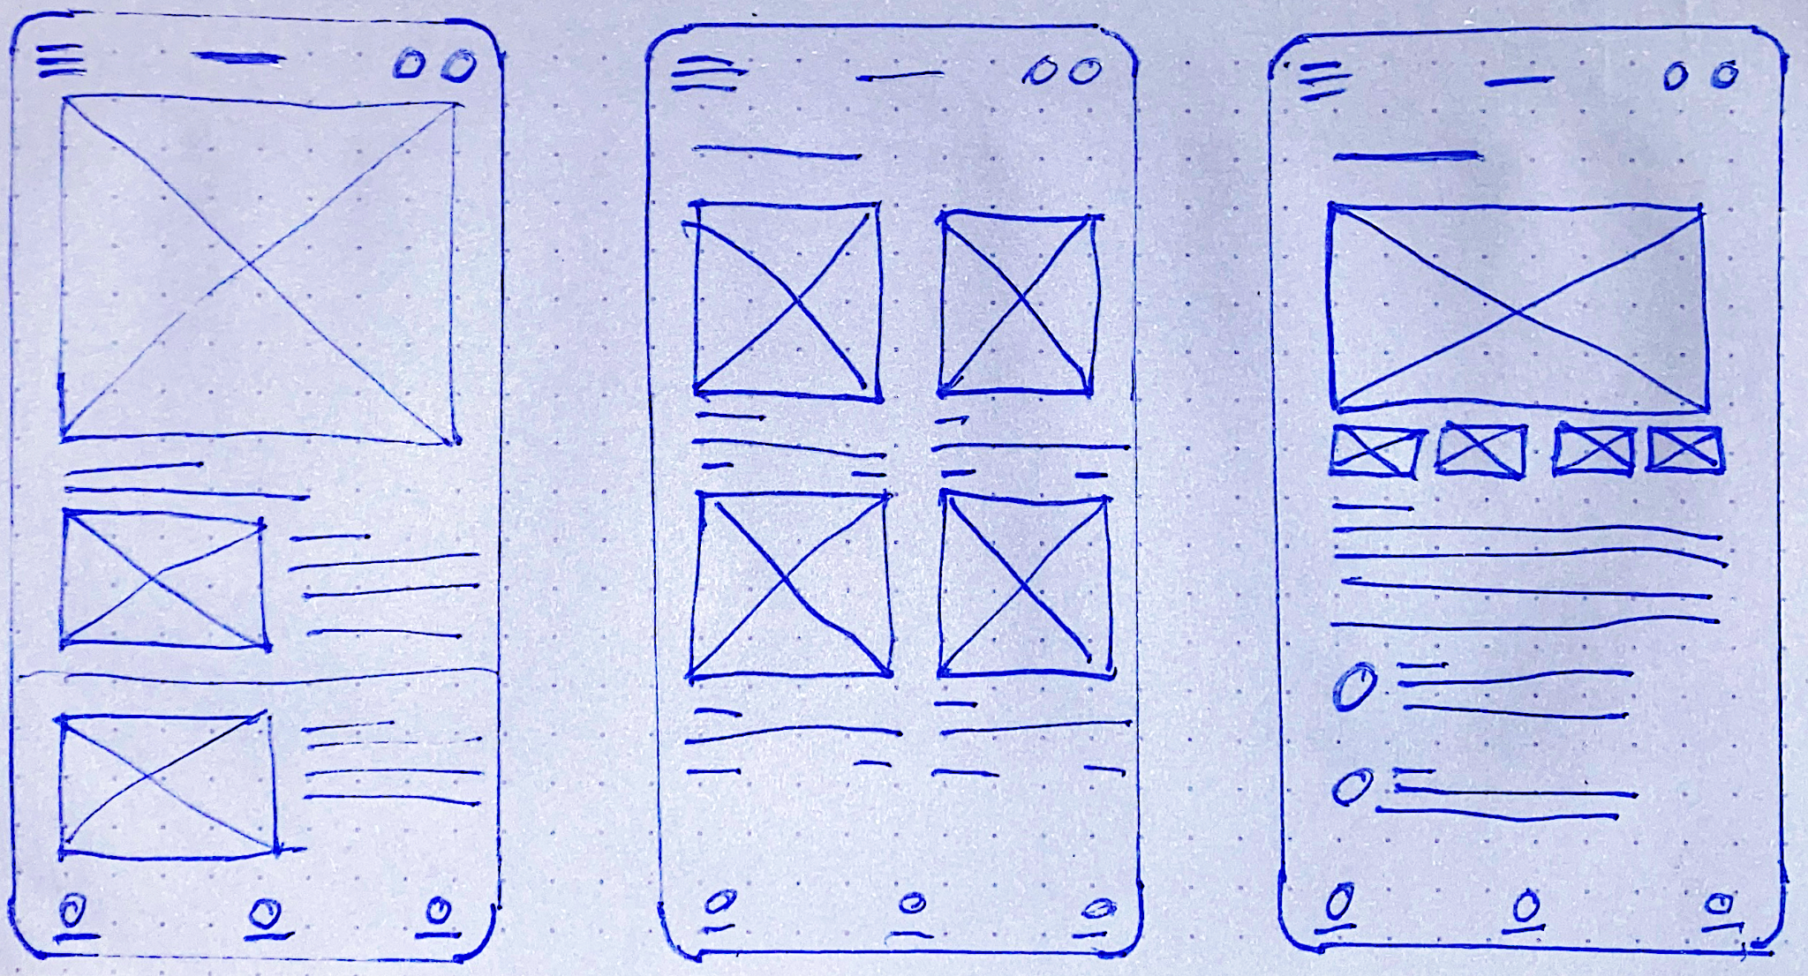
Paper wireframes
Paper wireframe includes home page, product page and product list

Slide 11
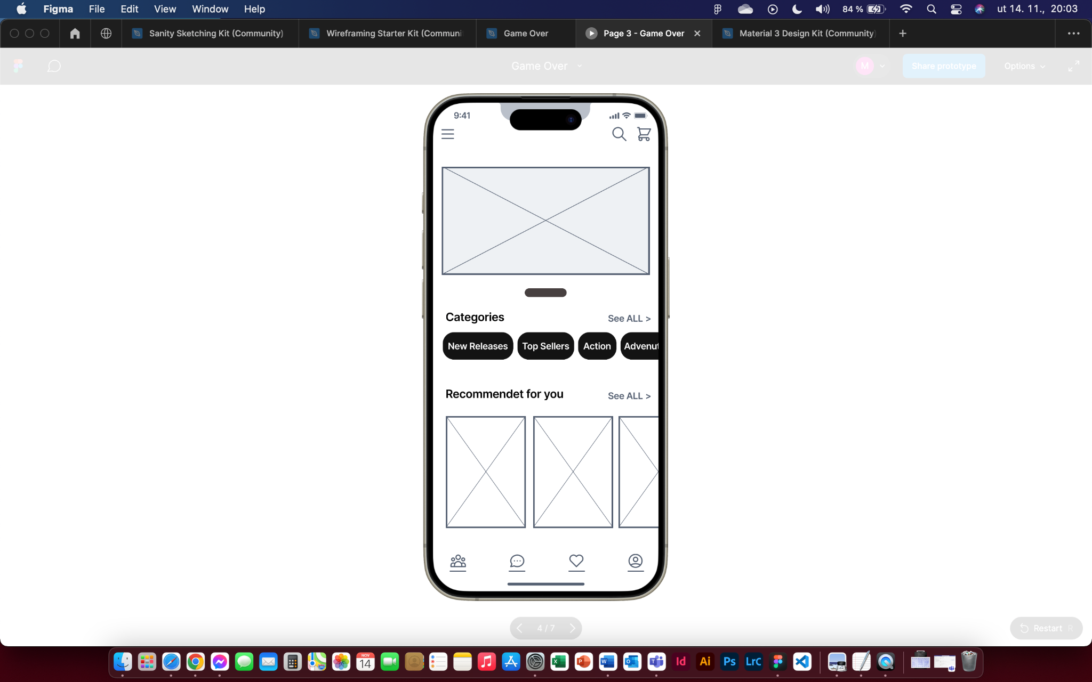
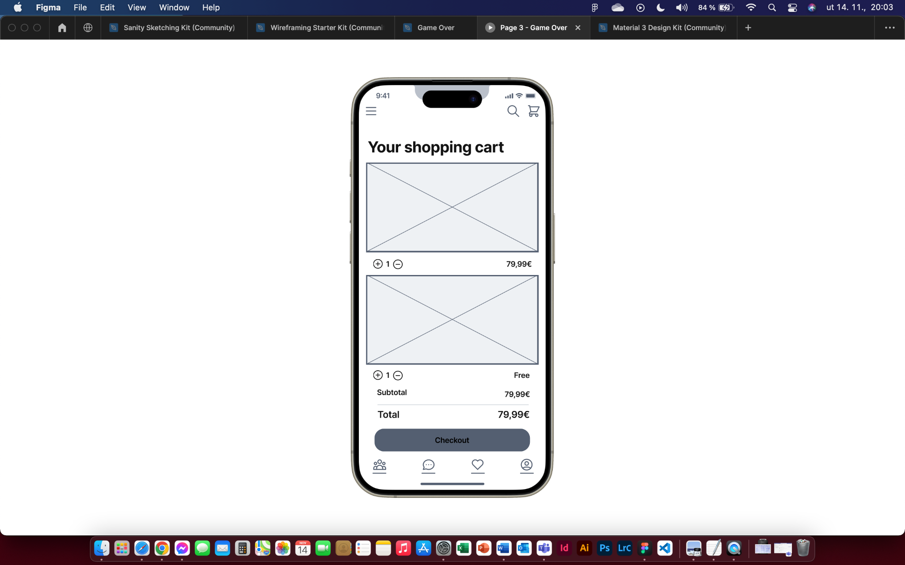
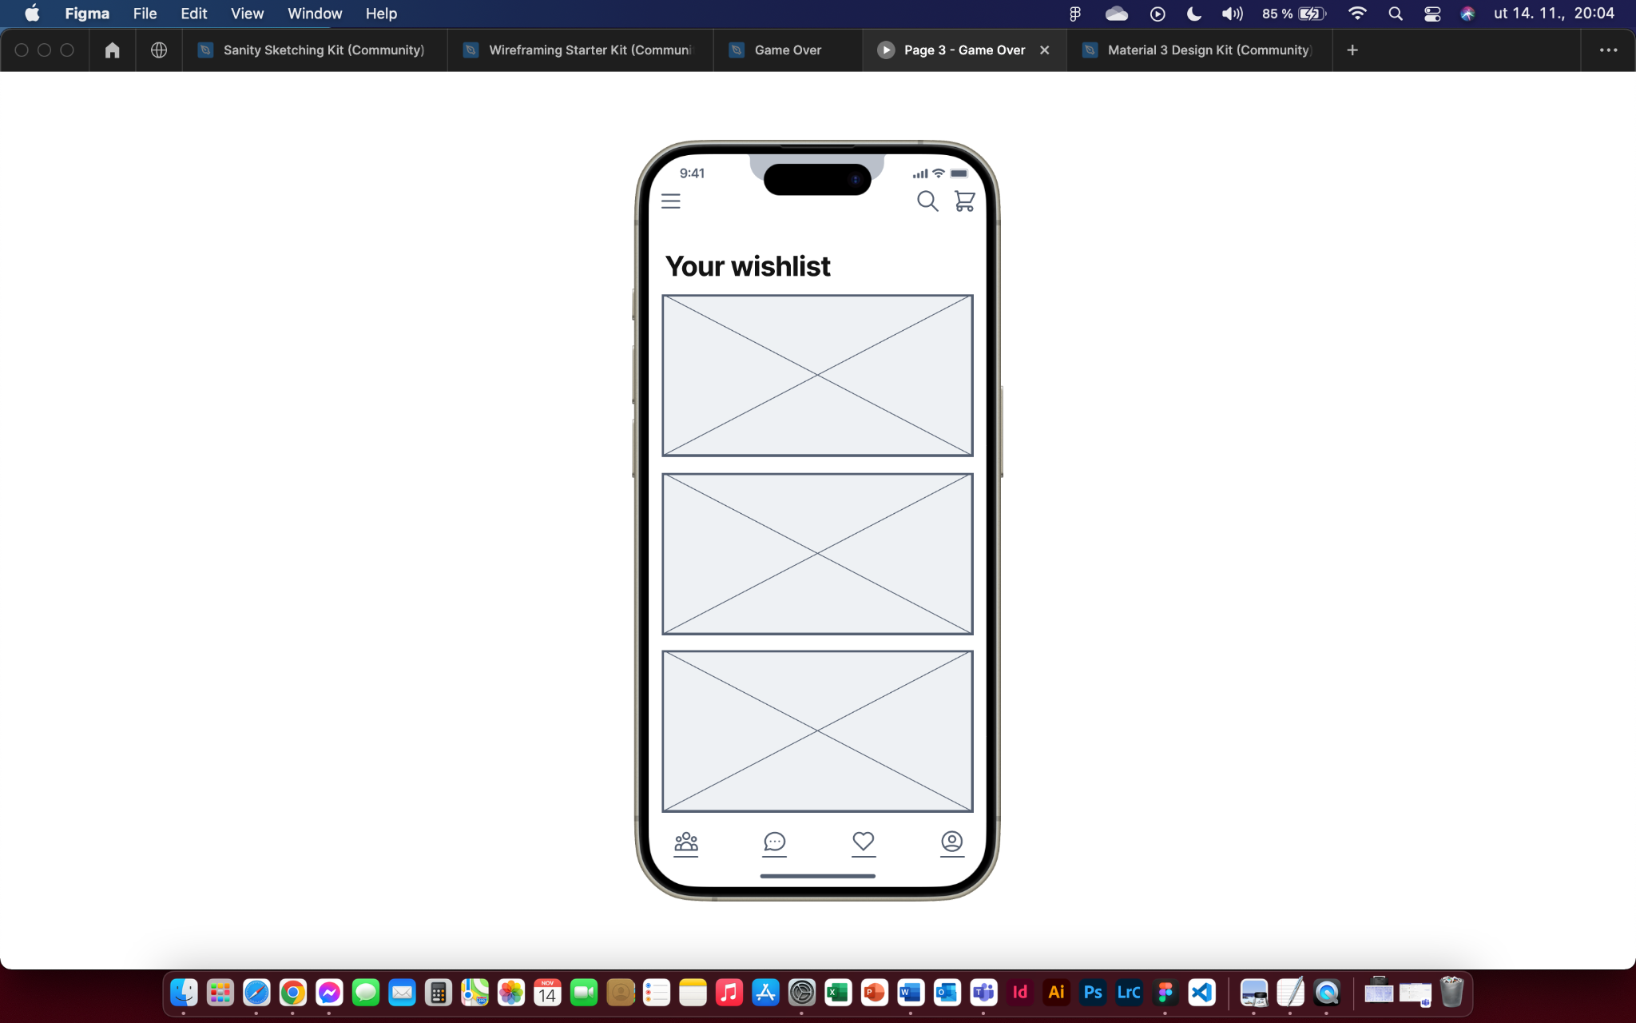
Digital wireframes
Users will see new game releases here
Recommendations based on previous views

Slide 12
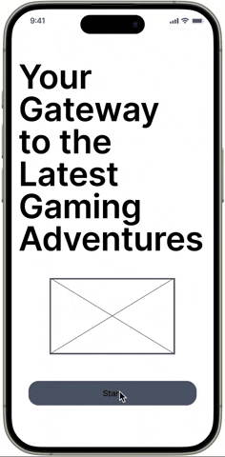
Low-fidelity prototype
The user flow for the gaming app begins with the login or registration process, allowing users to create or access their accounts. After authentication, users are directed to the homepage where they can browse recently released games or view recommended titles. They have the option to add games to their wishlist, modify profile information, and proceed to the cart to complete purchases, thereby culminating their interaction with the application.

Slide 13
Refining
the design
High-fidelity prototype

Slide 14
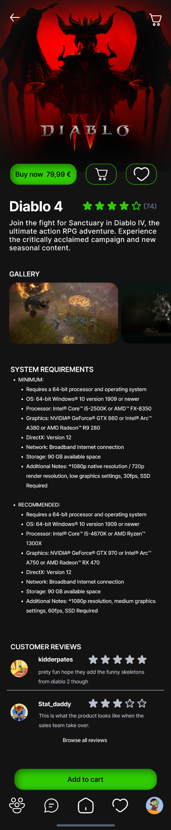
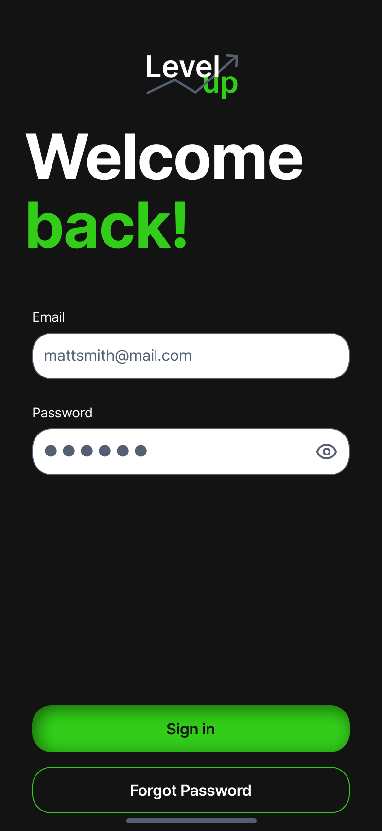
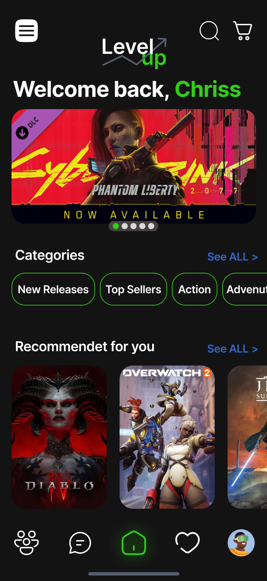
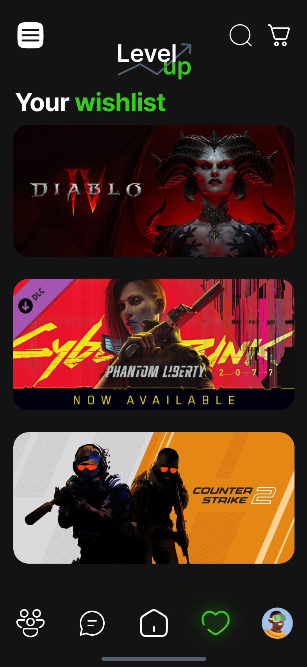
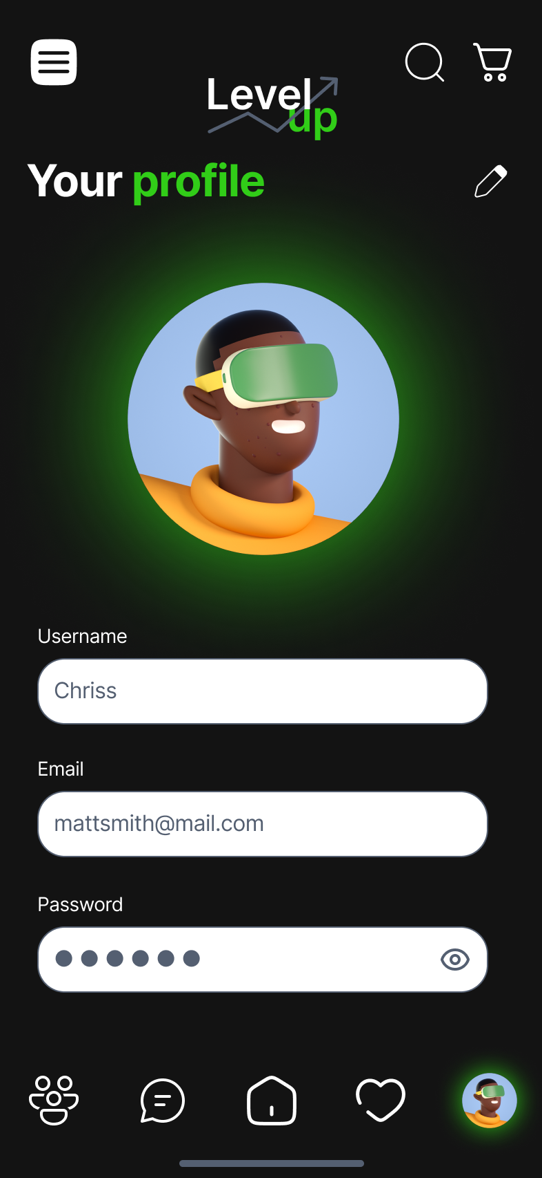
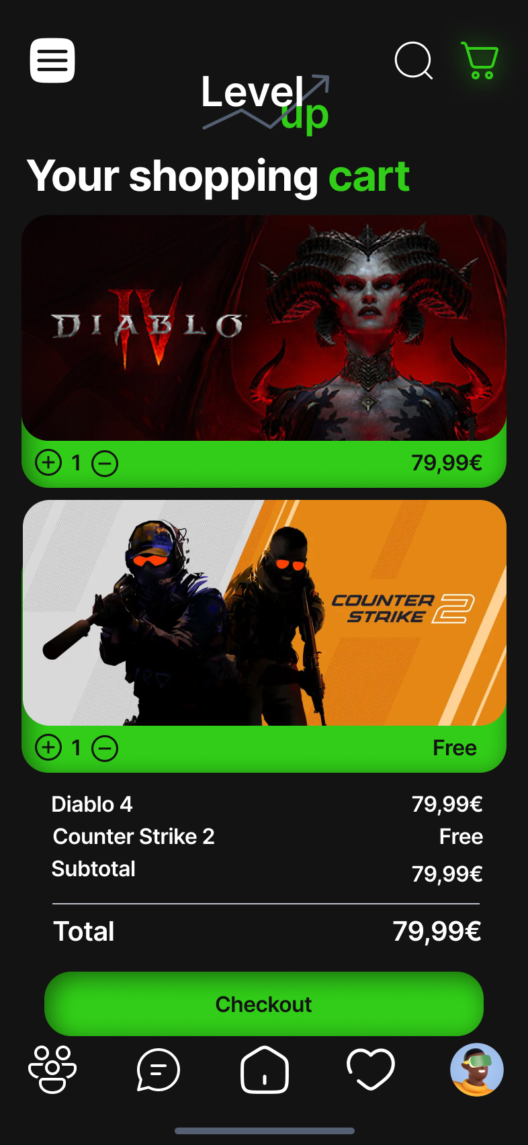
Mockups

Slide 15
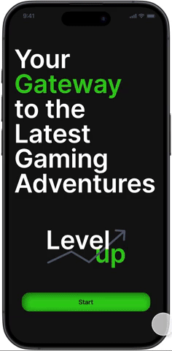
High-fidelity prototype

Slide 16
Going forward
Takeaways
Next steps

Slide 17
Takeaways
What I learned:
I learned how to use call to action, prototyping, mock-up creation, as well as low-fidelity prototype and high-fidelity prototype.

